Slide 1
SENTIMENT ANALYSIS FOR MARKETING
A PROJECT FOR ARTIFICIAL INTELLIGENCE

Slide 2
PROJECT OVERVIEW:
Sentiment analysis is a valuable application of artificial intelligence (AI) that involves the classification of text data into positive, negative, or neutral sentiments. While sentiment analysis is widely used in areas like social media monitoring and customer feedback analysis, an innovative approach can make it stand out and provide unique value. Here's an outlook for a sentiment analysis project with an innovative idea

Slide 3
PROJECT GOALS:
Develop an AI-powered sentiment analysis system that goes beyond traditional sentiment polarity classification and provides deeper insights into emotions and intentions.
Create a user-friendly interface or application that allows users to interact with the sentiment analysis tool and gain valuable insights from text data.
Integrate advanced natural language processing (NLP) techniques, machine learning models, and data visualization methods to enhance the accuracy and interpretability of sentiment analysis results.

Slide 4
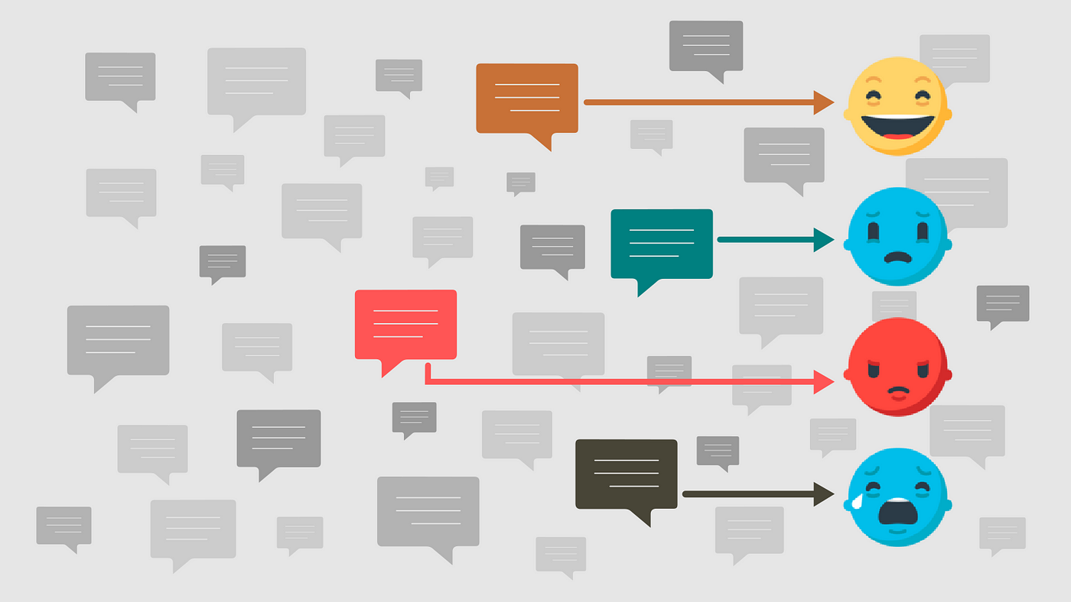
INNOVATIVE IDEA:
Implement Emotion Contextualization Rather than just classifying sentiments as positive, negative, or neutral, the innovative aspect of this project involves contextualizing emotions. Emotion contextualization aims to understand not only what emotion is expressed but also why and how it is expressed. This can provide a deeper understanding of user sentiments and intentions.

Slide 5
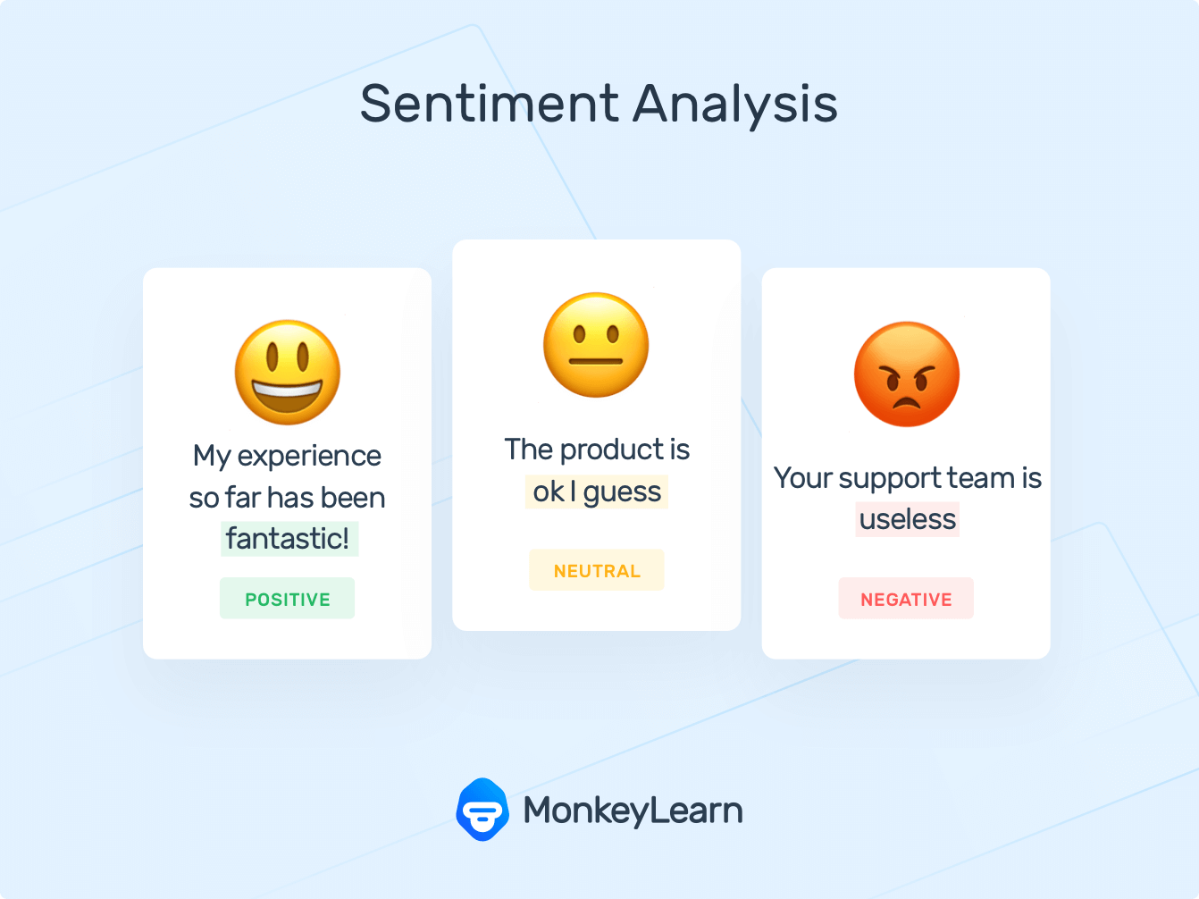
KEY FEATURES
Emotion Detection: Implement advanced NLP techniques to detect a wider range of emotions, such as joy, anger, sadness, fear, surprise, and more, within the text data.
Emotion Attribution: Identify the specific elements in the text that contribute to the expressed emotion, such as keywords, phrases, or linguistic patterns.
Emotion Trends: Analyze trends and patterns in emotion expression over time, helping users identify shifts in sentiment or emerging themes.

Slide 6
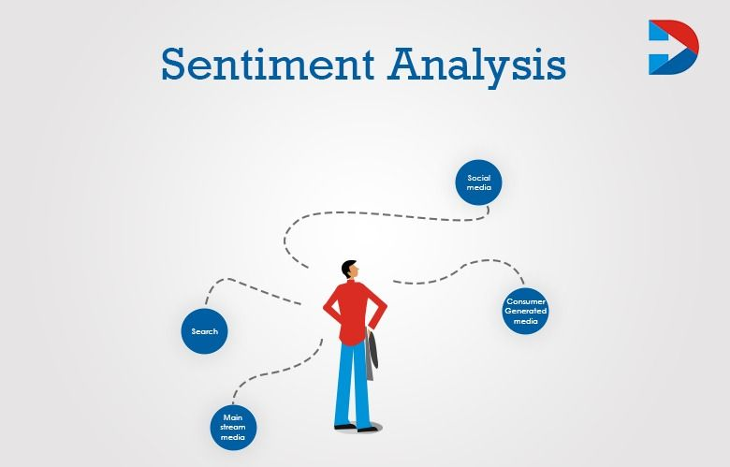
KEY FEATURES
Sentiment Intensity: Quantify the intensity of each emotion expressed, allowing users to gauge the strength of sentiment.
Sentiment Visualization: Create interactive visualizations that represent emotion and sentiment trends, making it easy for users to explore and understand the data.
Real-time Analysis: If applicable, develop a real-time sentiment analysis module that can process and display sentiment changes as new data is inputted.

Slide 7
TECHNICAL IMPLEMENTATION:
Utilize state-of-the-art NLP libraries and frameworks like spaCy, NLTK, or Transformers (e.g., BERT, GPT-3) for language processing and emotion detection.
Train and fine-tune machine learning models on large and diverse datasets to improve emotion detection accuracy.
Implement a user-friendly web or mobile application using technologies like Flask, Django, React, or Flutter for seamless interaction with the sentiment analysis tool.
Store and manage data efficiently using databases like PostgreSQL or MongoDB.
Deploy the application on cloud platforms like AWS, Azure, or Google Cloud for scalability and accessibility.
Develop an API for easy integration with other applications or services.

Slide 8
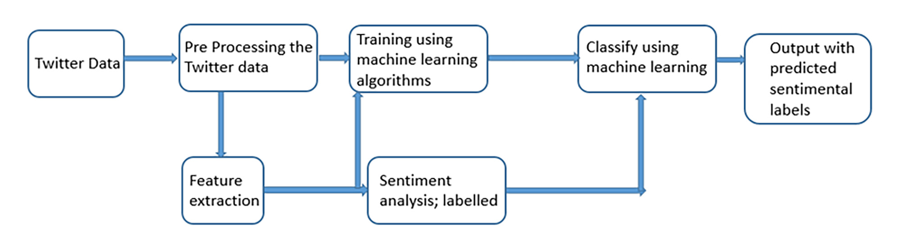
TWITTER AIRLINE DATASET ANALYSIS

Slide 9
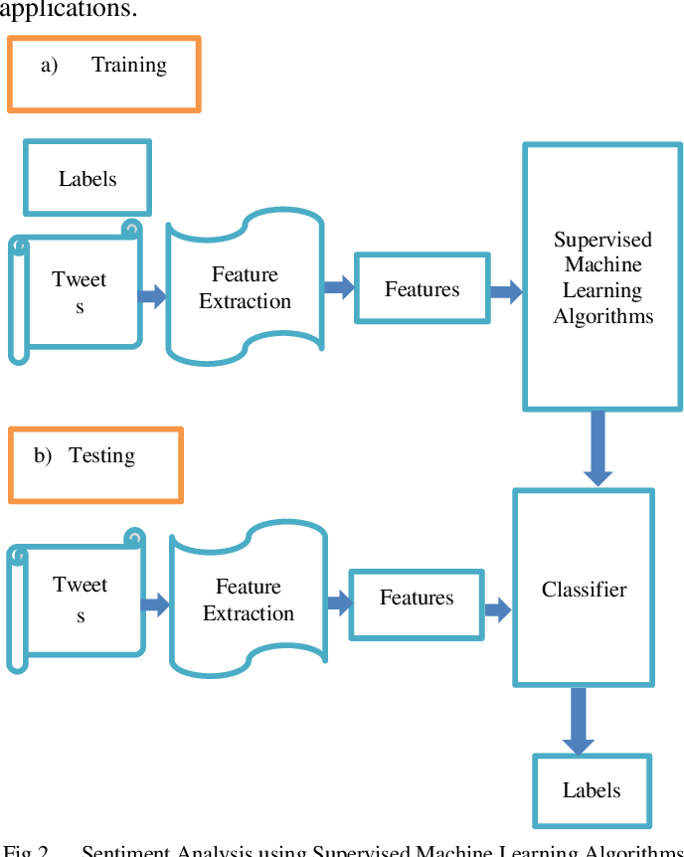
TWEETS ANLAYSIS

Slide 10
CHALLENGES:
Data Quality: Obtaining and curating high-quality labeled data for training emotion detection models can be challenging.
Ethical Considerations: Be mindful of ethical considerations when analyzing user-generated text, ensuring privacy and fairness in the analysis.
Model Interpretability: Making the results of the sentiment analysis interpretable and actionable for users is a key challenge.
Real-time Processing: Implementing real-time sentiment analysis may require optimizing performance and handling high concurrency.
User Experience: Designing an intuitive and engaging user interface is crucial for user adoption.

Slide 11
OUTCOMES AND BENEFITS
The innovative sentiment analysis system with emotion contextualization will offer users a more comprehensive understanding of text data, enabling them to make informed decisions in various domains, such as marketing, customer service, social media management, and more. It can help organizations better understand customer feedback, identify emerging trends, and respond to user sentiments effectively.
By focusing on emotion contextualization, this project can provide a unique and valuable perspective on sentiment analysis, setting it apart from traditional sentiment analysis tools.

Slide 12
THANKING YOU

